Slide 1

READI 1.0 Networks Survey Analysis

Slide 2
About the Networks Survey
The Purdue Center for Regional Development at Purdue University conducted a survey in an effort to understand the social networks (connections between organizations, colleagues and businesses) during the implementation of large-scale economic development projects throughout Indiana's regions. PCRD is working in conjunction with the Indiana Economic Development Corporation (IEDC) and Indiana University.
The information shared will be used to make recommendations to the state about what types of support regions need to ensure economically impactful projects in the future. The survey was completely anonymous
The survey garnered 25 valid responses representing 12 of the 17 READI 1.0 regions

Slide 3
Methodology
Data was collected through Qualtrics in the form of a survey. Over the course of 2 months, PCRD was able to garner 28 responses.
Of those 28 responses, 3 were at a completion rate less than 6%. Not providing any information about regional capacity or leadership, these three responses were cleaned from the data set.
Primarily, response analysis was completed using Qualtrics’s “Results” feature. We specifically looked at response frequency. Graphs and charts were developed utilizing percentage response and counts.
Cluster charts were employed to show relationships between similarly structured questions in the survey.
All qualitative data was read, analyzed, and summarized to represent the beliefs of the respondent. Specific quotes were included as well in our analysis.

Slide 4
High-Level Regional Analysis
A breakdown of the regions and their participation in the networks survey.

Slide 5
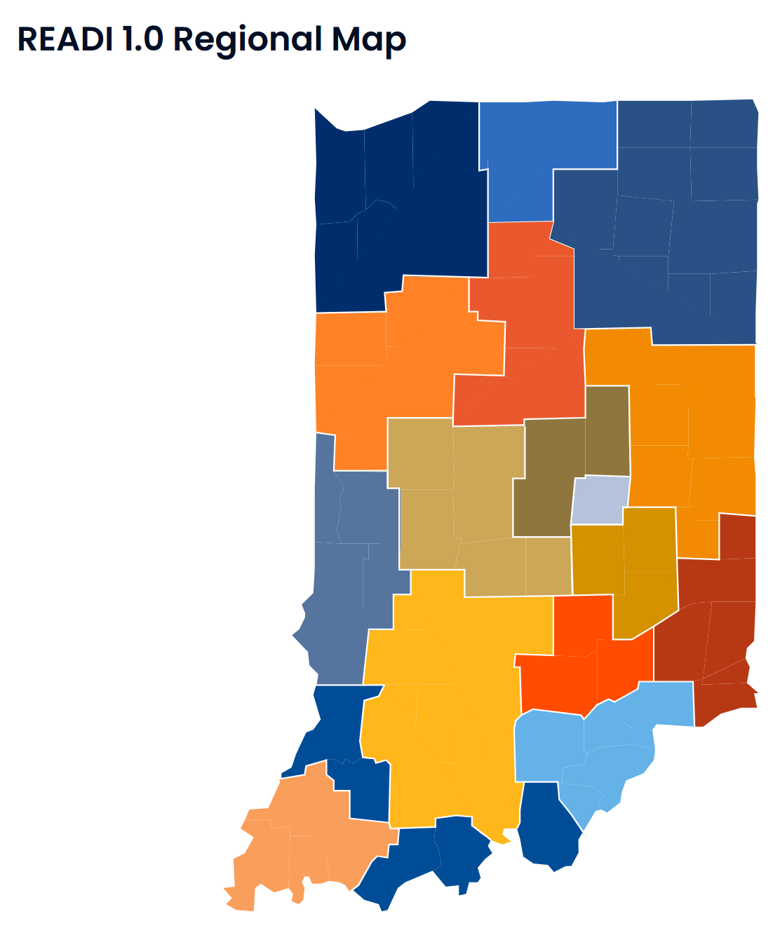
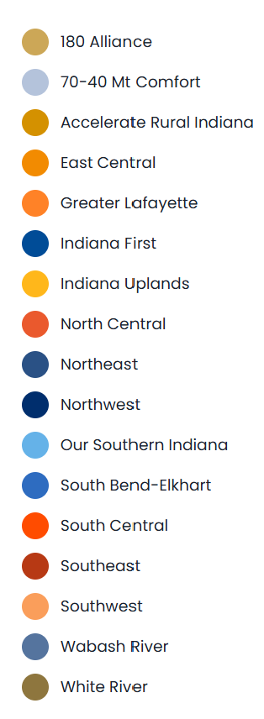
READI 1.0 Regions
Indiana and its regional communities have an opportunity to accelerate economic resilience and growth and become magnets for the talent Hoosier businesses need to thrive. By developing a collaborative, long-term plan for growth, regional communities throughout the state will have a game plan to invest in their future growth and prosperity, deliberately and thoughtfully.

Slide 6

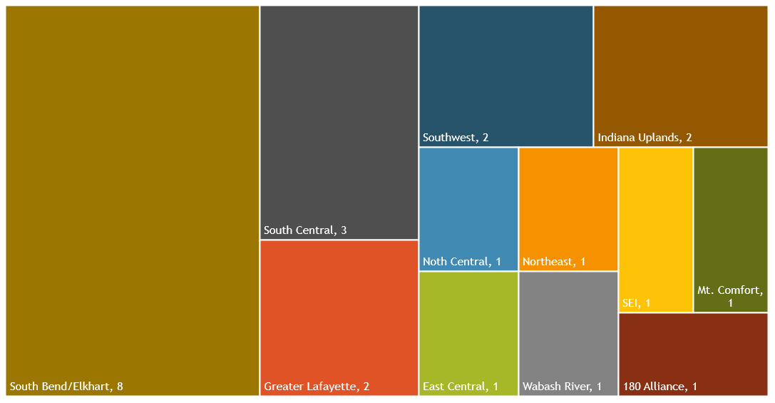
Regional Participation (12)
Notes:
ARI, Indiana First, Northwest, Our Southern Indiana, White River

Slide 7
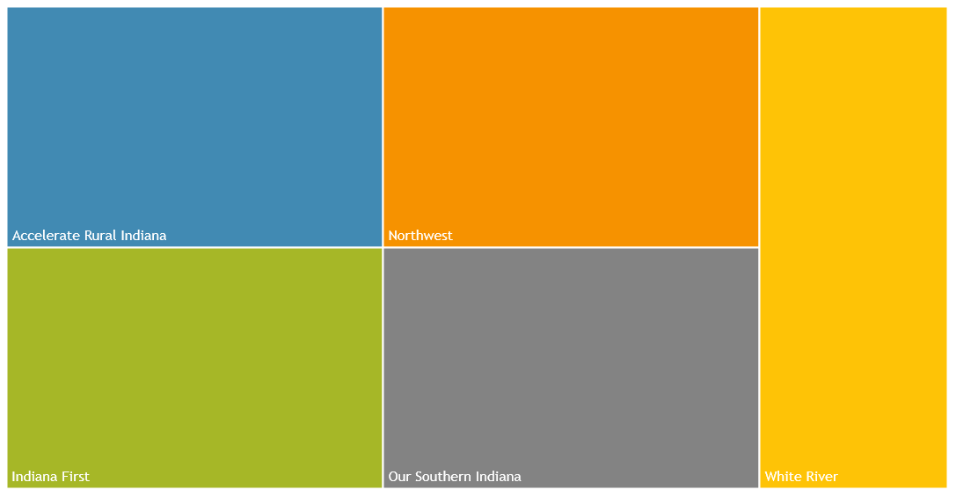
Non-Participating Regions (5)

Slide 8
Aggregate Analysis
A breakdown of the responses gathered across Indiana’s 17 READI 1.0 Regions

Slide 10
Organization and Leadership
A breakdown of the responses gathered across Indiana’s 17 READI 1.0 Regions

Slide 12
Notes:
The majority of regional project teams have established a clear purpose, vision, and goals for the board members and collaborators. However, the fewer respondent had planned for organizational structure.

Slide 13
Regional Analysis

Slide 14

Notes:
84% of all respondents have a publicly available website. Of those, types of individual projects (14), project news (12), and financial allocations (12). Fewer regional organizations listed project contact information (4) or project maps (5).

Slide 15
Notes:
When considering board level meetings, eight of the respondents had no intention of making their meetings accessible to the public. However, other regions utilize media coverage (6) and meeting minutes (7) to make their meetings accessible.

Slide 17
Please write in what you think could constitute as challenges that you foresee in your region at this stage related to leadership, project management and/or implementation of the grant.
Key points drawn from feedback
The combination of regions between READI 1.0 and 2.0 has been challenge for communication around the projects and leadership at the regional level
Macroeconomic forces impacting construction costs and/or unexpected cost surges
Staffing size, too little planning funding, and too little administration funding to properly execute the READI 1.0 strategic investment plan.
Note: This was echoed numerous times across the survey. In the survey, two regions requested a higher administrative fee (more than 3%) for regional sustainability
Evolving IEDC requirements and lack of transparency on program requirements has made successful planning and implementation difficult.

Slide 18
Organizational Collaboration
A breakdown of the responses gathered across Indiana’s 17 READI 1.0 Regions

Slide 20
Which individuals or organizations should be invited to participate in this project that have not or cannot? Why were they not able to participate?
Organizations that did not participate
Small non-profit organizations were excluded in the READI 1.0 process but should have been included.
What limited that participation?
Organizations not having full time staff to dedicate to the time-consuming nature paperwork, applications, and reporting.
Complicated application, approval, and funding process discouraged smaller scope projects from being submitted for consideration.
Very few small towns were equipped to source or organize READI projects in 2022.
Overall lack of resources and lack of capacity.

Slide 30
Financial Capital and Resources
A breakdown of the responses gathered across Indiana’s 17 READI 1.0 Regions

Slide 31
Notes:
Project primarily have access to county foundation (13) and philanthropic financial capital (12). Very few regions utilized zero stage venture capital, angel investors, or micro-loans to fund READI 1.0 projects.

Slide 33
READI Program Administration and Success
A breakdown of the responses gathered across Indiana’s 17 READI 1.0 Regions

Slide 37
Please provide details for all outside expertise and consultation used for this READI project.

Slide 38
What ways are any perceived risks being mitigated by the regional team?
Utilization of outside legal advice
Regular meetings to review key actions, project progress, and collaboratively address challenges.
Audit review and debarment checks implemented.
Use of an invoice portal and quarterly reporting system.
Use of a comprehensive monitoring system for all project stages.
Focus on ensuring all funding is effectively utilized.
Plans to hire additional full-time employees (FTEs) to address capacity risks.
Monthly updates provided to the Region on project status.
Emphasis on stakeholder engagement.

Slide 39
What do you consider to be the most significant barriers to the planning and deliverance of your READI project within current arrangements?
Ranked responses
1. Lack of appropriate governmental oversight at the state level (4.79)
2. Lack of project lifecycle risk (3.93)
3. Lack of skills or resources to pursue a fully collaborative approach (3.79)
4. Lack of local or regional policies or regulations to support project scope and future (3.36)
5. Weak incentive or returns (such as funding) (2.93)
6. Political challenges to inclusion and/or collaboration (2.21)

Slide 40
Please give brief details to explain your chosen ranking and/or identify any additional barriers not listed in the above question.
Key points drawn from feedback
3% admin fee does not support enough capacity to support individual project execution from a technical assistance perspective.
While the view is to approach the effort regionally, there are multiple layers of government in-between that create regionally challenges.
Lack of local community resources
Lack of capacity at regional organizations managing the projects/funds

Slide 41
Conclusions
Conclusions and findings from the analyzed data

Slide 42
Organization and Leadership Conclusions
The majority of regional project teams have established a clear purpose, vision, and goals for the board members and collaborators. However, the fewer respondent had planned for organizational structure.
84% of all respondents have a publicly available website. Of those, types of individual projects (14), project news (12), and financial allocations (12). Fewer regional organizations listed project contact information (4) or project maps (5).
When considering board level meetings, eight of the respondents had no intention of making their meetings accessible to the public. However, other regions utilize media coverage (6) and meeting minutes (7) to make their meetings accessible.
Board meeting times vary but are primarily once a month (11).

Slide 43
Organizational Collaboration Conclusions
When considering organizational relationships, positive relationships were recorded with higher education institutions (100%), local nonprofit organizations (87%), workforce organizations (87%), construction companies (87%), and municipal organizations (87%). For those organizations mentioned above, respondents noted that if they did not have a positive relationship, they had a neutral one. None of these core relationships had a negative perspective. However, negative relationships were noted specifically with homeless veterans & seniors (52%), national nonprofits with local offices (36%), and people with disabilities (36%).
When finding differences between project resource and project partner participation, youth and youth service organizations were primarily used as a resource but not permitted to participate in project planning (78%). On the other hand, civic engagement was noted as an important planning partner (78%) and less of a resource (22%). The remaining organizations served about equally as project partners and project resources.
Surprisingly, 64% of respondents noted that there has not been the creation of any community/economic development partnership coalitions since the project’s inception.

Slide 44
Financial Capital and Resources Conclusions
Project primarily have access to county foundation (13) and philanthropic financial capital (12). Very few regions utilized zero stage venture capital, angel investors, or micro-loans to fund READI 1.0 projects.
Despite 64% of respondents noting that there has not been the creation of any community/economic development partnership coalitions since the project’s inception, 73% of regions claim that the creation of community/economic development partnership coalitions occurring since the project's inception has increased local and/or regional investments.

Slide 45
READI Program Administration and Success Conclusions
87% of respondents have signed MOU’s/contracts or are in the process of signing MOU’s/contracts with program partners.
Project management is being monitored by one lead agency in 60% of the regions. 33% of respondents noted that project management is being led by one lead agency with multiple partnerships.
Risk is being mitigated by the regions through the utilization of reporting and comprehensive monitoring systems
2/3 (66%) used an external consultant to aid in the construction of their READI 1.0 plan and its implementation.
Regions are requesting a higher administration fee (more than 3%) so that they may be better able to increase capacity and complete projects

