Slide 1

READI 1.0 Wellbeing Survey Analysis

Slide 2
About the Wellbeing Survey
The Purdue Center for Regional Development at Purdue University has conducted a survey in an effort to gain the sense of belonging and community pride in our counties during the implementation of large-scale economic development projects throughout Indiana's regions. This effort is a collaboration with the Indiana Economic Development Corporation (IEDC) and Indiana University.
The survey was completely anonymous
The survey garnered 353 valid responses across 16 of Indiana’s 17 READI 1.0 regions

Slide 3
Methodology
This survey was administered through Qualtrics garnering 407 responses. Of those responses, 353 were valid. Respondents that had completed less than 6% of the survey were culled from the final survey analysis.
PCRD utilized IMB’s SPSS software to analyze results from the survey. Each county was coded to represent its license plate number. Each region was coded to include the counties within it. Because the distribution of responses was not equally spread throughout the State, PCRD opted to pursue aggregate analysis instead of regional focuses.
Although PCRD did utilize bivariate testing, there was no evidence of correlation between the responses. Thus, the primary source of analysis was frequency tables.
Graphs and charts were developed in Microsoft Excel. Scale based questions utilized cluster charts so as to easily exhibit the data.
This survey did not contain qualitative responses and thus, did not require for individual responses to be read.

Slide 4
High-Level
Regional Analysis
A breakdown of the regions and their participation in the well being survey.

Slide 5
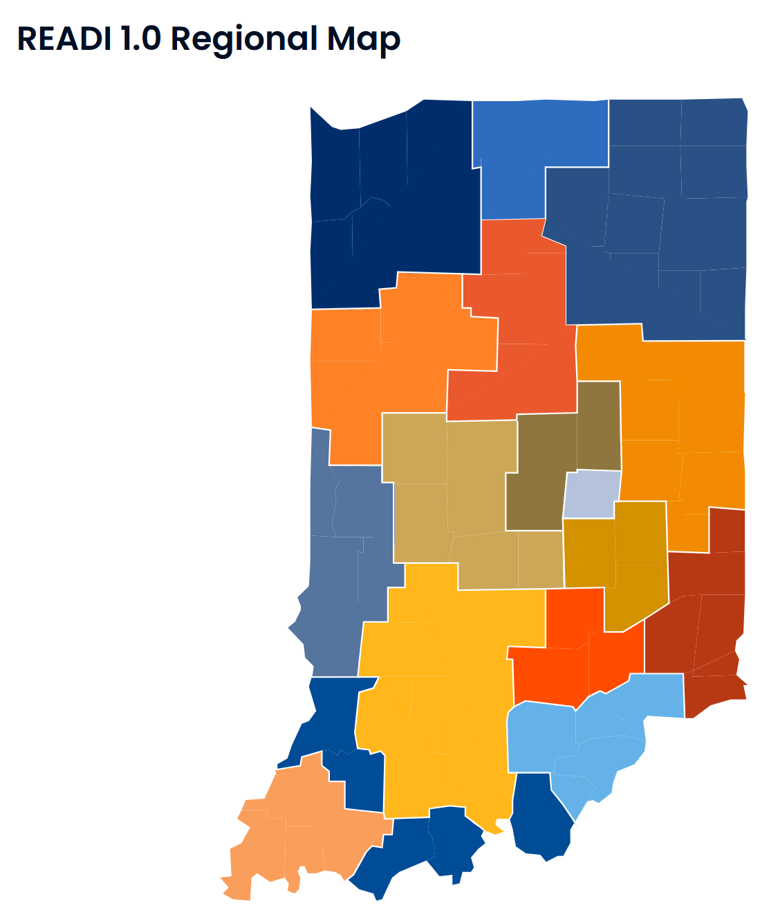
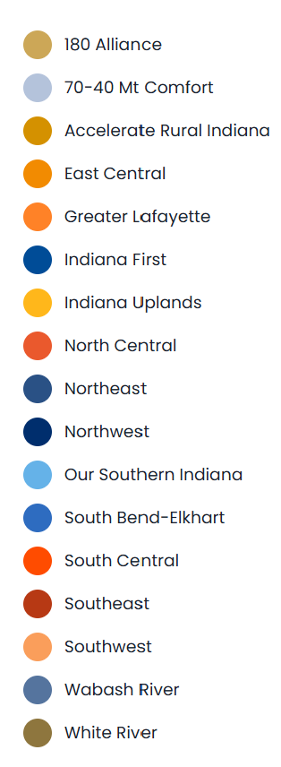
READI 1.0 Regions
Indiana and its regional communities have an opportunity to accelerate economic resilience and growth and become magnets for the talent Hoosier businesses need to thrive. By developing a collaborative, long-term plan for growth, regional communities throughout the state will have a game plan to invest in their future growth and prosperity, deliberately and thoughtfully.

Slide 6

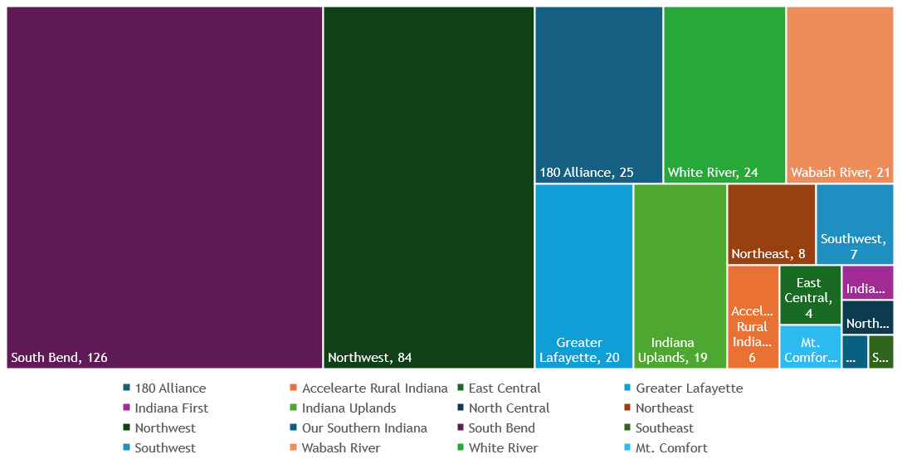
Regional Participation

Slide 7
Aggregate Analysis
A breakdown of the responses gathered across Indiana’s 17 READI 1.0 Regions

Slide 8
Survey Respondent Demographics
A breakdown of the responses gathered across Indiana’s 17 READI 1.0 Regions

Slide 9
Survey Respondent Demographics

Slide 10
Survey Respondent Demographics

Slide 11
Survey Respondent Demographics

Slide 12
Survey Respondent Demographics

Slide 13
Survey Respondent Demographics

Slide 14
Survey Respondent Demographics

Slide 15
Community Analysis
A breakdown of the community dynamics in Indiana’s 17 regions

Slide 19
READI 1.0 Response Analysis
A breakdown of the READI process and its perceived strengths/weaknesses

Slide 20
READI 1.0 Response Analysis

Slide 22
Conclusions
Conclusions and findings from the analyzed data

Slide 23
Survey Respondent Demographics Conclusions
South Bend and Northwest Regions make up 58.8% of all responses gathered
Most (74%) of respondents had resided in their county for greater than 10+ years
Most (85%) of respondents were very interested in knowing what was going on in the county, but only 36% were very actively involved.
Most respondents have a four-year degree

Slide 24
Community Analysis Conclusions
58% of respondents believe that a small number of people influence county decisions
Q.7 – Most individuals have a positive outlook on their community with many respondents selecting “Agree” as the primary choice
  Excluding presence of high-paying jobs in the county. That was pretty evenly split between “Agree” and “Disagree”
Q. 9 – Since COVID-19, many individuals acknowledge that jobs and the economy, community events, and affordable broadband increased. However, since COVID-19, affordable housing prices and childcare have gotten worse.
  Many responses fall in the “Not Sure” category indicating that respondents are still feeling the impact of COVID-19 and have not seen much growth or decline

Slide 25
READI 1.0 Analysis Conclusions
78.8% of respondents were aware of the READI 1.0 Program
Across the board, responses indicate a positive response to the READI 1.0 program and its administration
  Specifically, respondents were confident in the organizations overseeing the READI 1.0 plan and that the timeline for implementing the READI 1.0 plan was transparent and achievable
  However, “I feel well-informed about the goals and objectives of the READI plan” and “I believe the allocated resources for the READI plan are sufficient” is relatively split between positive and negative responses

